Slide 1
Population Modeling
Cole Brookson & Alex Davis
19 October 2021

Slide 2
Biology is Math

Slide 3

Aside...
What has been will be again,
what has been done will be done again;
there is nothing new under the sun.
Notes:
I truly believe it’s important to think about and account for how we’ve been doing science for generations – it can never be TRULY new, and that’s the point
In like the third century Soloman wrote Ecclesiastes and in which there is this verse regarding novelty

Slide 4
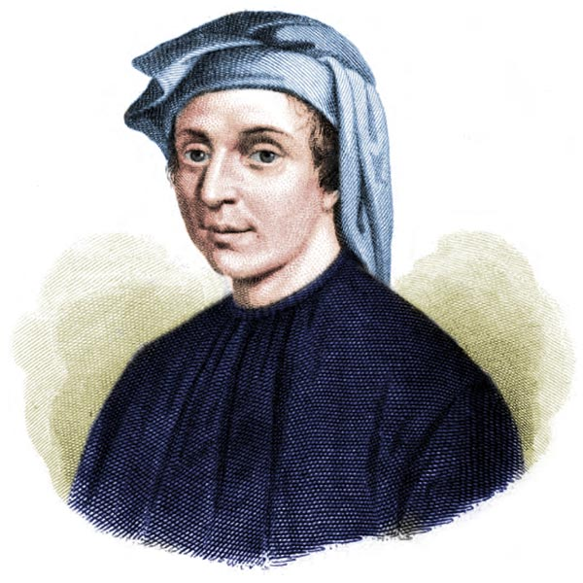
Notes:
Math bio can be traced back to as early as the 13th century and fibbonaci used is his famous fibonacci sequence to describe rabbit population growth
In the West, the Fibonacci sequence first appears in the book Liber Abaci (1202) by Leonardo of Pisa, known as Fibonacci. Fibonacci considers the growth of an idealized (biologically unrealistic) rabbit population, assuming that:
a single newly born pair of rabbits (one male, one female) are put in a field;
rabbits are able to mate at the age of one month so that at the end of its second month a female can produce another pair of rabbits;
rabbits never die and a mating pair always produces one new pair (one male, one female) every month from the second month on.
The puzzle that Fibonacci posed was: how many pairs will there be in one year?

Slide 5
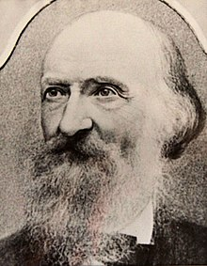
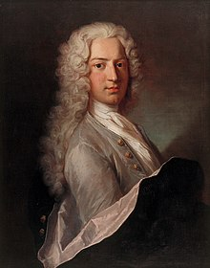
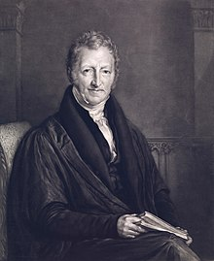
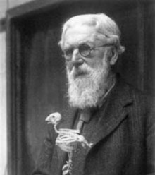
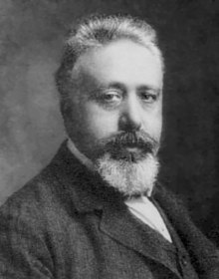
Notes:
Mathematics has been used in biology as early as the 13th century, when Fibonacci used the famous Fibonacci series to describe a growing population of rabbits. In the 18th century Daniel Bernoulli applied mathematics to describe the effect of smallpox on the human population. Thomas Malthus' 1789 essay on the growth of the human population was based on the concept of exponential growth. Pierre François Verhulst formulated the logistic growth model in 1836.
Fritz Müller described the evolutionary benefits of what is now called Müllerian mimicry in 1879, in an account notable for being the first use of a mathematical argument in evolutionary ecology to show how powerful the effect of natural selection would be, unless one includes Malthus's discussion of the effects of population growth that influenced Charles Darwin: Malthus argued that growth would be exponential (he uses the word "geometric") while resources (the environment's carrying capacity) could only grow arithmetically.[6]
The term "theoretical biology" was first used by Johannes Reinke in 1901. One founding text is considered to be On Growth and Form (1917) by D'Arcy Thompson,[7] and other early pioneers include Ronald Fisher, Hans Leo Przibram, Nicolas Rashevsky and Vito Volterra.[8]

Slide 6

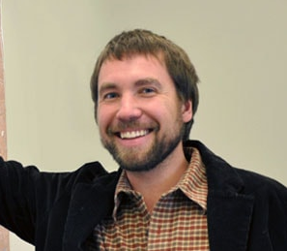

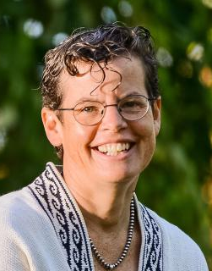
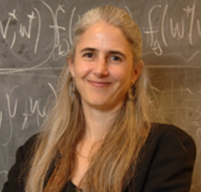


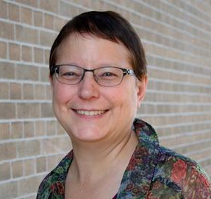


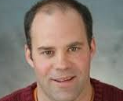
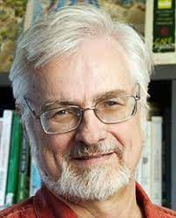
Mark Kot - Washington
Sally Otto - UBC
Mark Lewis – UAlberta/UVic
Martin Krkosek - UToronto
Mercedes Pascual – UChicago
Troy Day - Queens
Jennifer Dunne – Santa Fe
Hal Caswell - WHOI
Michael Dietze – Boston University
Marie-Josee Fortin - UToronto
Kevin McCann -
Guelph
John Vandermeer - UMich
Notes:
The people who came before me
Good to note there are more white men named mark on this slide then there are women of colour but here we are...

Slide 7

Is biology really math though??
35% of Ecology and Evolution papers, and 60% of American Naturalist papers had results that depended on a mathematical model
“A picture is a 1000 words” –> well an equation is (sometimes) worth even more
Otto & Day (2007)

Slide 8
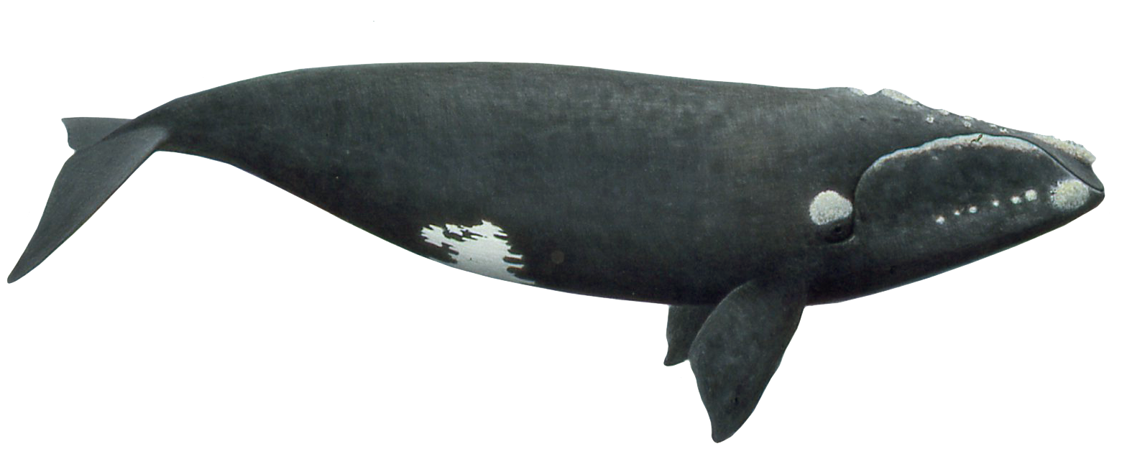
Why do we use models?
Notes:
Ask if anyone knows what this is
Northern right whale – a great marine example of “WHY” we use models in ecology to ask ecological (and management-related) questions

Slide 9
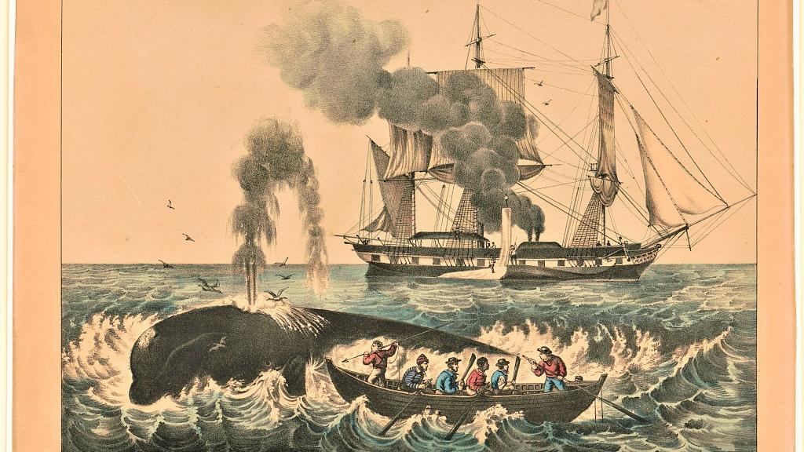
Notes:
Because of their docile nature, their slow surface-skimming feeding behaviors, their tendencies to stay close to the coast, and their high blubber content (which makes them float when they are killed, and which produced high yields of whale oil), right whales were once a preferred target for whalers.

Slide 10
How do you know if the right whale will or will not recover?
Impossible to answer this question without a model!
Notes:
The problem is: we don’t actually KNOW how the whales will grow next year, we can only guess. And given limited resources, we have to make some assumptions about how a population will grow.
But first, let’s talk about what we mean by the term model

Slide 11
Population Growth

Slide 12
Population Growth
Density Independent
Density Dependent

Slide 13
The Exponential Equation
Let’s say there exists a pond with some lily pads
Notes:
Let’s say you have a pond with some lily pads – each lily pad replicates itself once a week

Slide 14
The Exponential Equation
They replace themselves once a week – the pond is half covered in a year...
how long until the whole pond is covered?
Notes:
Let’s say you have a pond with some lily pads – each lily pad replicates itself once a week and it takes a year for half the pond to become covered?

Slide 15
The Exponential Equation
Only one more week!
Notes:
Let’s say you have a pond with some lily pads – each lily pad replicates itself once a week and it takes a year for half the pond to become covered?

Slide 16
The Exponential Equation

Slide 17
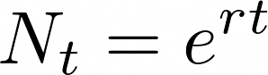
The Exponential Equation
Notes:
From here, we also actually need to represent this as a rate of change. I won’t walk through this, but the rate of change of the log of any variable is equal to the derivative of that variable divided by the value of the variable. This requires some differentiation which we are NOT covering here, but what you DO need to know is that after some finangling we will end up with this

Slide 18
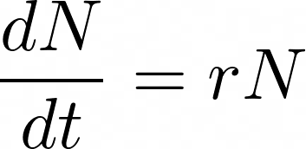
The Exponential Equation
Notes:
Now what you’re actually looking at here is the rate of change of N with respect to t, being given by r (this birth rate) multiplied by N.

Slide 19
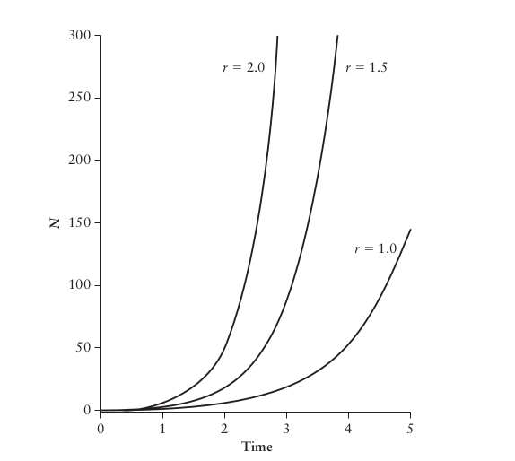
The Exponential Equation

Slide 20
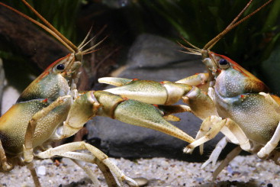
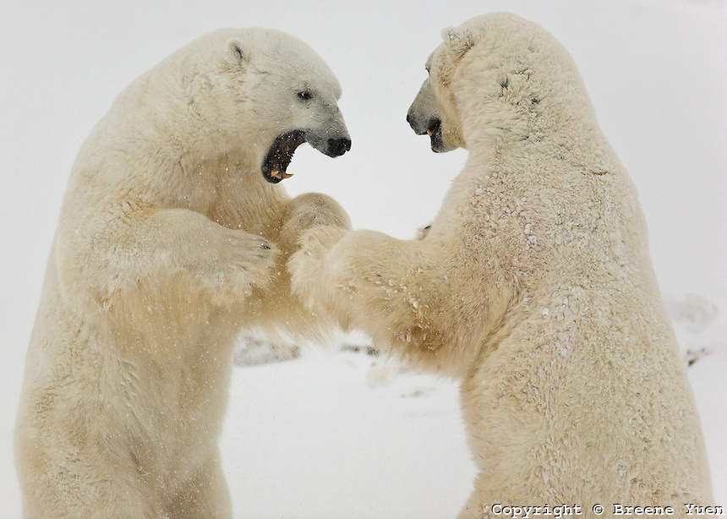
Density Dependence
Notes:
It might be kind of intuitive to us now, but the idea that populations will not grow exponentially was only first formally proposed by Thomas Malthus in the 1800s, and he said this first about human populations.

Slide 21
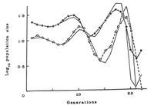
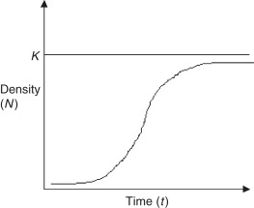
Density Dependence
Nicholson & Bailey (1935) formalized “regulation of populations through density dependence” as a result of intraspecific competition
Milne (1961) took these conclusions and, having seen patterns in the environment, said density dependence only happens at high abundance
Notes:
It might be kind of intuitive to us now, but the idea that populations will not grow exponentially was only first formally proposed by Thomas Malthus in the 1800s, and he said this first about human populations.
But Nicholson and Bailey first really went through this in detail, and in the past 90 years or so there has been a ton of debate in the literature about how and to what level density dependence actually takes place

Slide 22
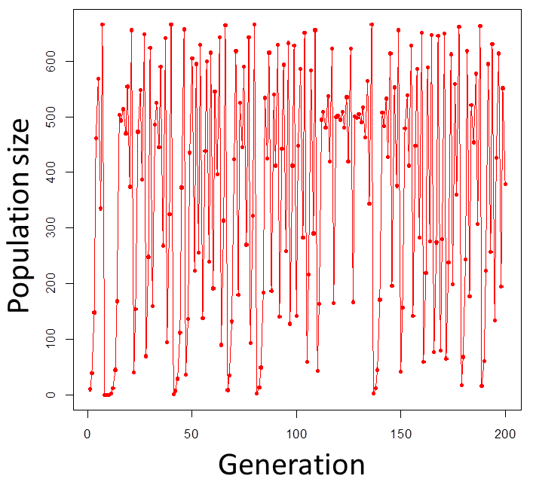
Density Dependence
We also began to understand that populations under density-dependent control may actually be chaotic (Gukenheimer et al. 1977) even though they appear to be density independent
Notes:
Chaos is a mechanism which can generate random-looking time series from simple deterministic systems.

Slide 23
Logistic Equation
Notes:
So our goal now is to incorporate some component of density dependence into our exponential growth equation that we were working with previously

Slide 24
Population Growth

Slide 25
Dynamic Mathematical Models
Describe how a system changes over time
Can be deterministic (future entirely determined by model) or stochastic (random events the system, model can only predict probability of various outcomes)
Any biological system can be modeled!

Slide 26
How do you know if the right whale will or will not recover?
Well, let’s frame it as a mathematical question
Notes:
The problem is: we don’t actually KNOW how the whales will grow next year, we can only guess. And given limited resources, we have to make some assumptions about how a population will grow. In order to do that, let’s frame it mathematically

Slide 27
But wait, to do so, we need a more specific biological question

Slide 28
7 Steps to Modeling A Biological Problem
1. Formulate the question
2. Determine the basic ingredients
3. Qualitatively describe the biological system
4. Quantitatively describe the biological system
5. Analyze the equations
6. Checks & balances
7. Relate the results back to the question
Otto & Day (2007)

Slide 29
7 Steps to Modeling A Biological Problem
1. Formulate the question
2. Determine the basic ingredients
3. Qualitatively describe the biological system
4. Quantitatively describe the biological system
5. Analyze the equations
6. Checks & balances
7. Relate the results back to the question
Otto & Day (2007)

Slide 30
But wait, to do so, we need a more specific biological question
“How will northern right whale populations grow?”

